Slide 1


Selection Builder: A custom query interface and self-service tool
Ben Seitz, Mark Santoski
University of New Hampshire

Slide 2


Ben Seitz
Mark Santoski
https://www.unh.edu/give/directory/seitz-benjamin
https://www.unh.edu/give/directory/santoski-mark
Senior Programmer Analyst
.NET Developer
AT UNH
AT UNH
Six years
Three years
Portsmouth, NH
Dover, NH
I believe that creating presentation videos are hard. I probably should have just winged it.
I believe that I hid the fact that I recorded all my videos in 90+ degree room.

Slide 3
Ben Seitz
Mark Santoski
https://www.unh.edu/give/directory/seitz-benjamin
https://www.unh.edu/give/directory/santoski-mark
Senior Programmer Analyst
.NET Developer
AT UNH
AT UNH
Six years
Three years
Portsmouth, NH
Dover, NH
I believe that creating presentation videos are hard. I probably should have just winged it.
I believe that I hid the fact that I recorded all my videos in 90+ degree room.

Slide 4

University of New Hampshire
Durham, New Hampshire
Established 1866
Public research institution
Land, Sea, Space Grants
11 schools and colleges
Over 15,000 students
Endowment of over $400 million

Slide 5
Advancement Information Technology
Director of Information Technology for Advancement
Associate Director of Advancement IT
Sr. Business Intelligence Analyst
Senior Associate Director of IT
Senior Programmer Analyst
.Net Developer
Sr. Business Analyst
Sr. Business Analyst
Desktop Support via SLA w/Central IT
Desktop Support via SLA w/Central IT

Slide 6
Blackbaud CRM at UNH Advancement
Went live: October 2018
Converted from: Banner Advancement
Rebranded as Trax
Self-Hosted via central IT
1 Production Environment
Load Balanced Webserver, High Availability SQL Server
3 Test Environments
Load Balanced Webserver, High Availability SQL Server
3 Development Environments
Heavy use of BBDW, feeds into SAP Web Intelligence and Tableau
Over 150 distinct customizations of varying sizes

Slide 7
Selection Builder Introduction
Needed an easy way for all users of CRM to be able to create selections of constituents
Ad-hoc Query did not seem to meet the needs for the global scale of all users due to complexity
Created during CRM implementation
Continues to receive updates
Wide user use: over 2,200 selections created
Built in security for selections

Slide 8
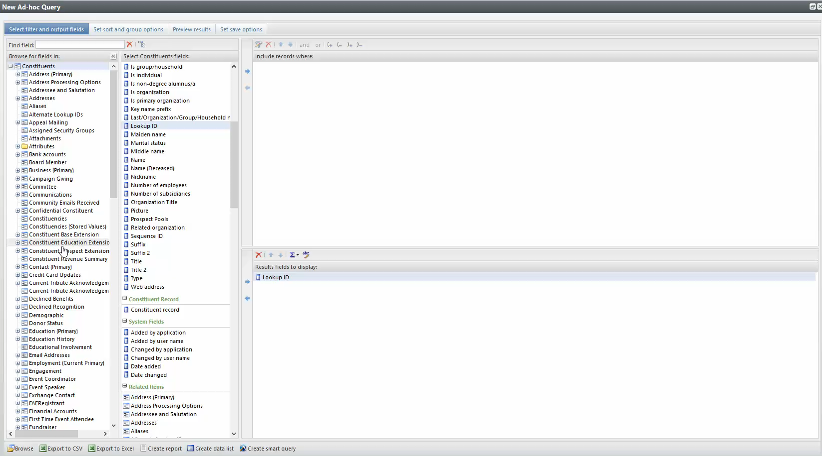

Slide 9
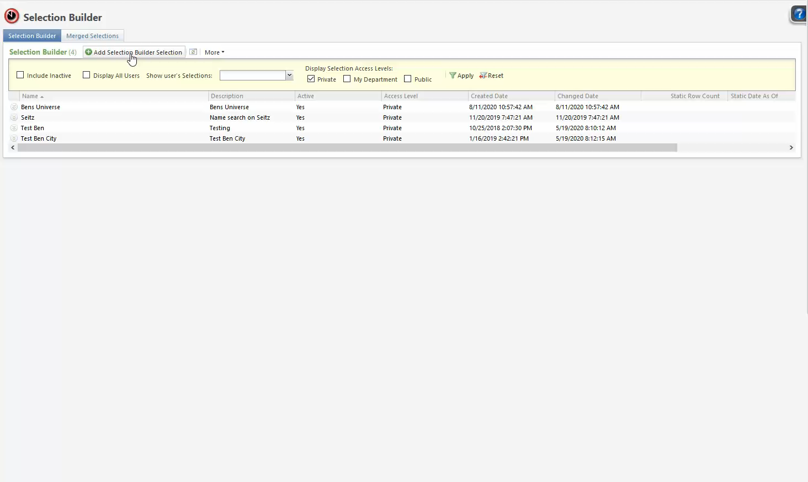

Slide 10
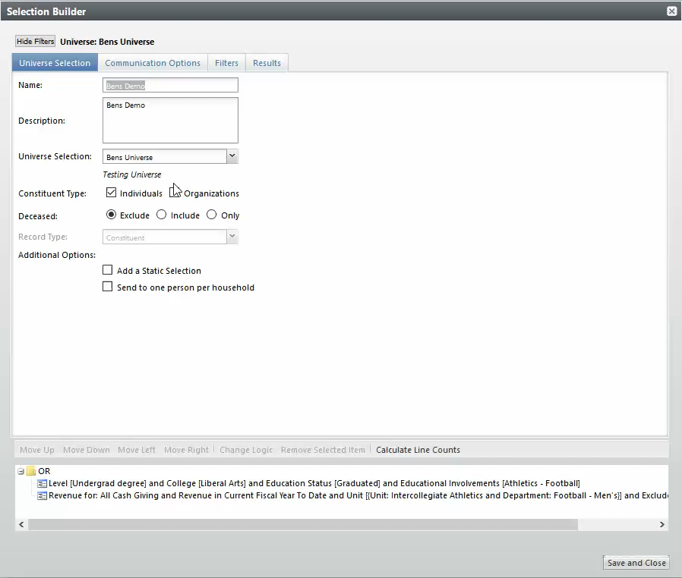
Filters for most areas of CRM
User friendly generated text of what a selection is performing
Tool Tips available as needed

Slide 11
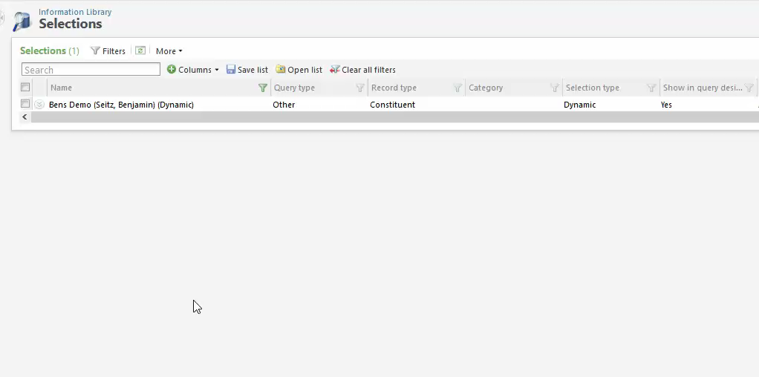
Creates a Selection like any Ad-Hoc Query Selection
Can be paired with an Export Definition

Slide 12
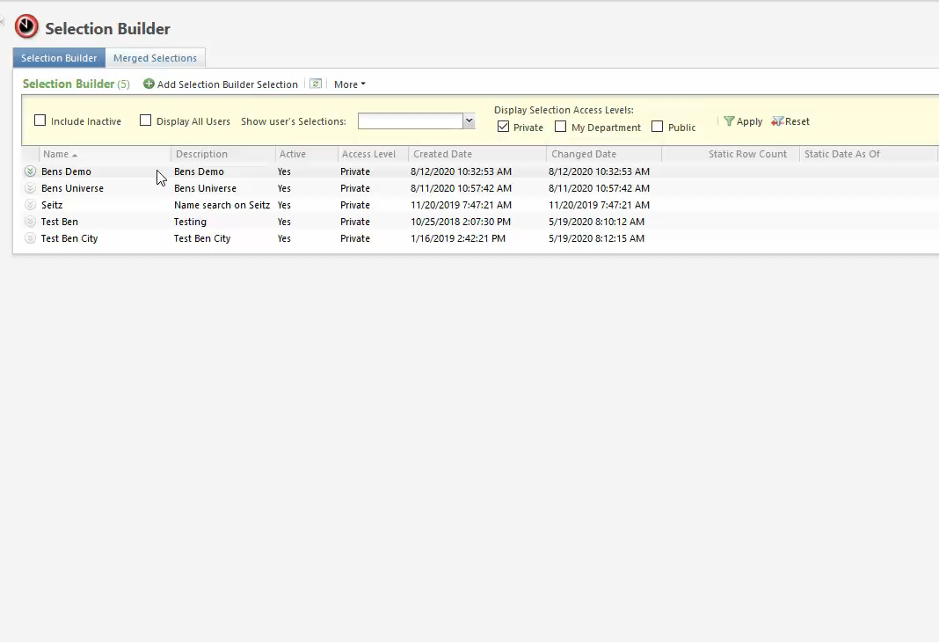
Static Selections allow use within Segments

Slide 13
Selection Builder Creation Process
Code walkthrough of how a selection is created via selection builder

Slide 14
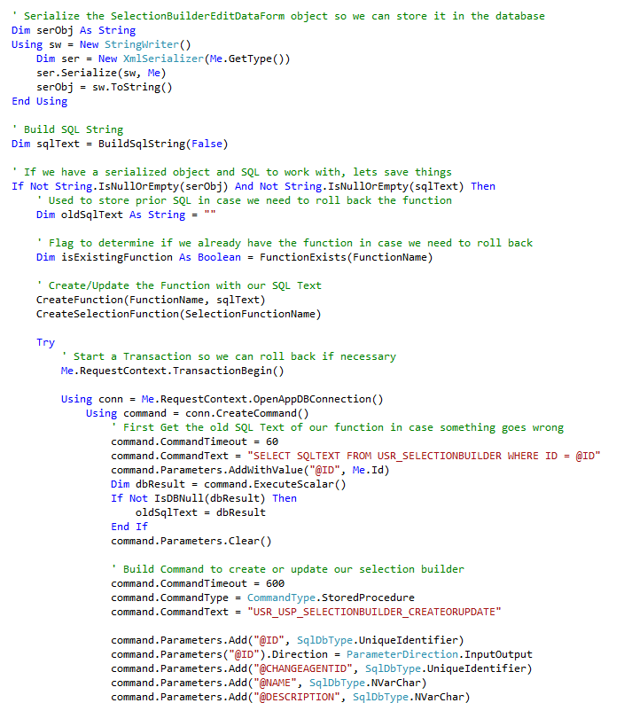
Data Form Class Object Serialized into XML
SQL Generated from saved filters
SQL Functions created to use in IDSETREGISTER records
Selection Builder record saved to database
IDSETREGISTER records generated

Slide 15
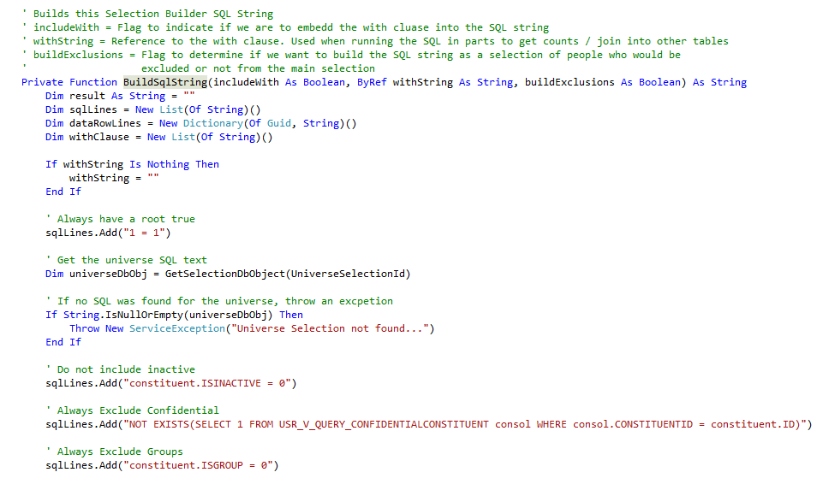
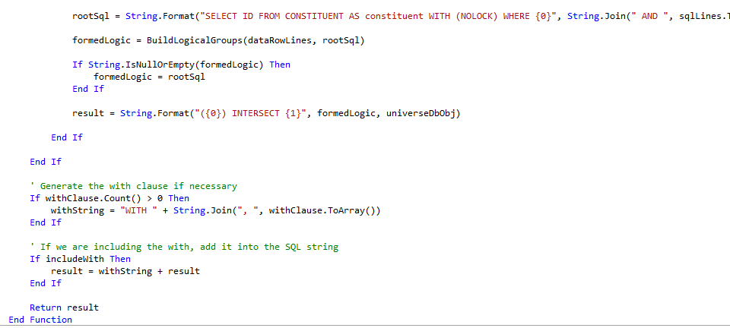
A Single SQL Query is Generated
Includes default filters included in every selection
Selection criteria is intersected with universe selection object

Slide 16
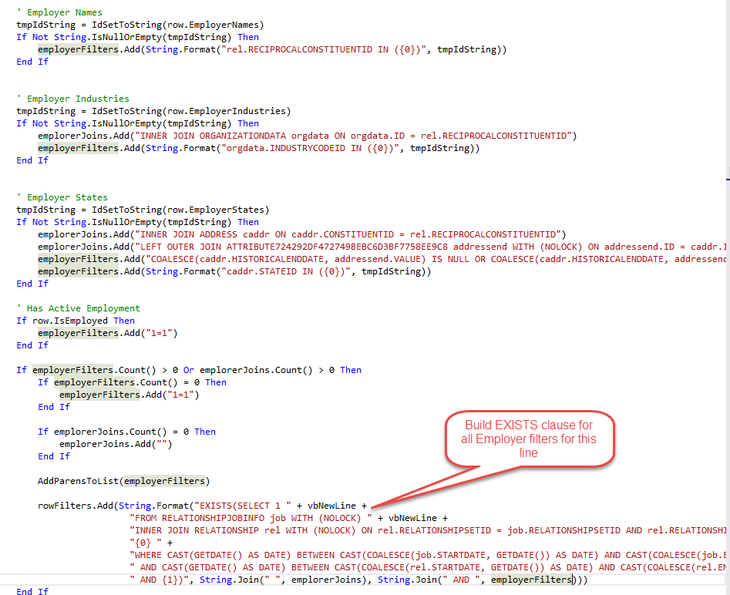
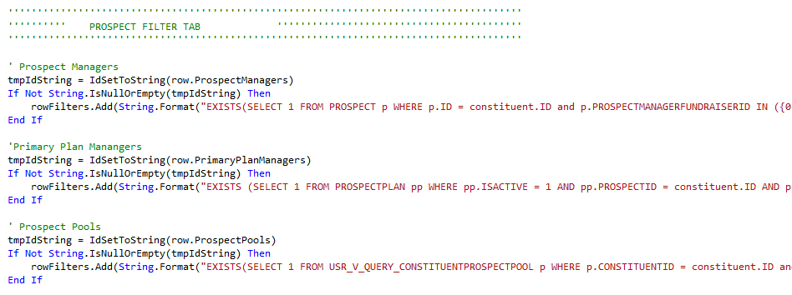
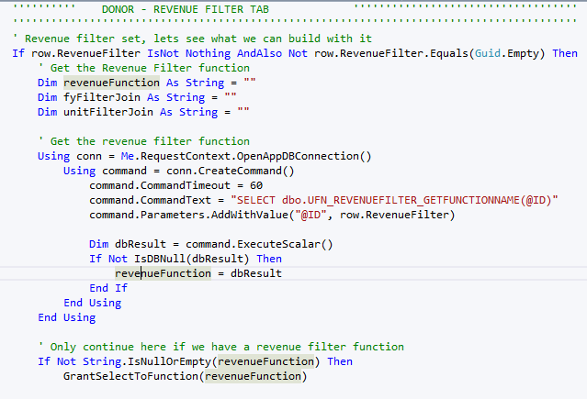

Slide 17
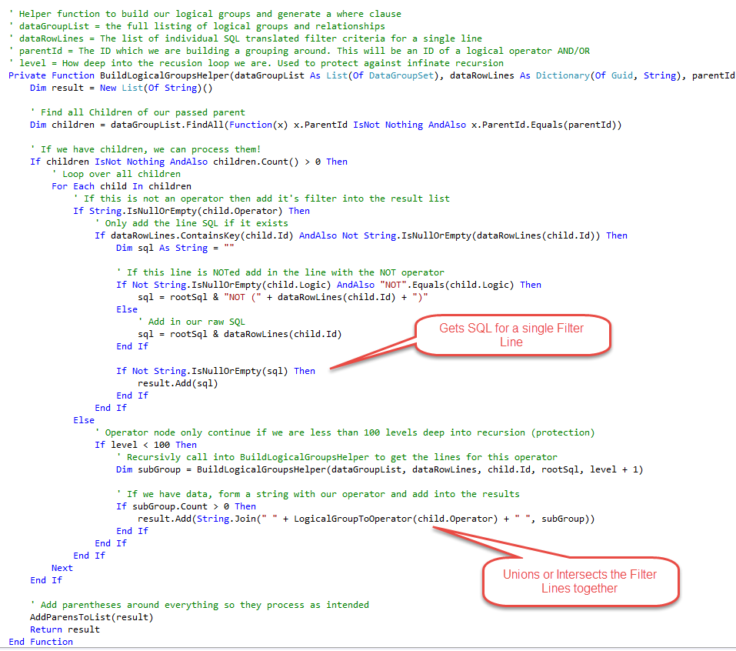
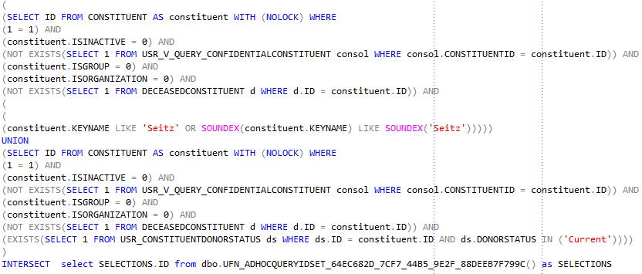
All Filter lines are UNIONed or INTERSECTED together based operator logic (AND/OR)
Supports nesting of operators down multiple levels

Slide 18
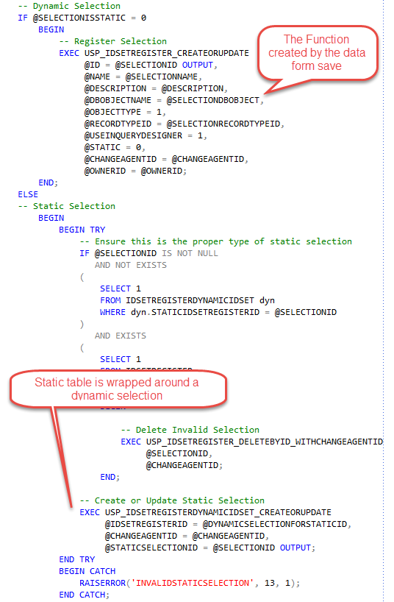
Using the SQL Functions created during the data form Save, an IDSETREGISTER record is created using the baseline procedures
A static selection gets two IDSETREGISTER records. One for the dynamic selection, and a second for the static table.
The two are linked, allowing for Direct Marketing Effort Segments to be refreshed utilizing the dynamic selections

Slide 19
Selection Builder UI Model
Discussion of parts of the Selection Builder UI Model

Slide 20
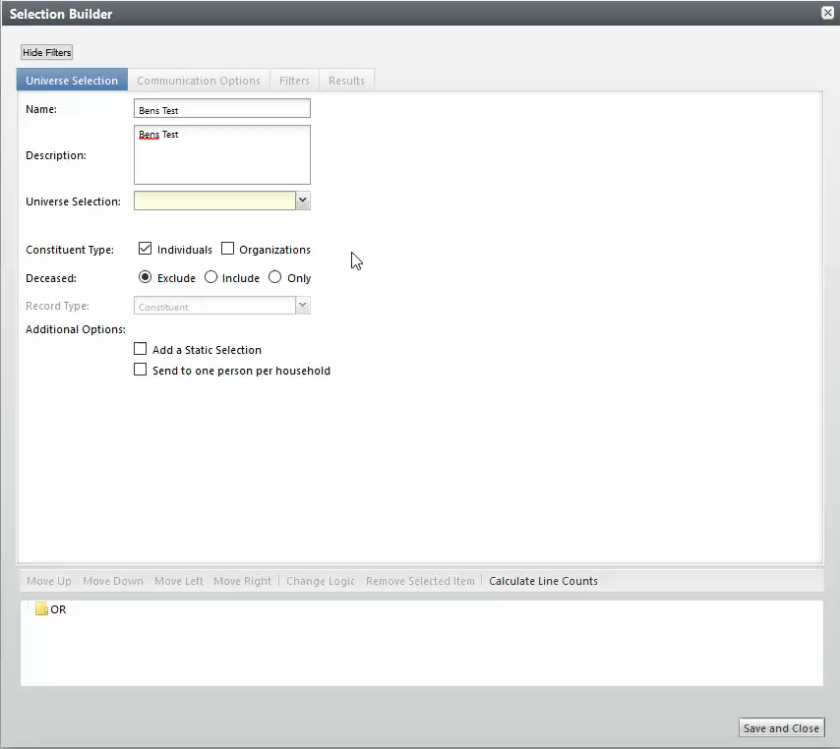
Universe description dynamically populated and always displayed at the top.
Most filterable fields are collections to allow multi-select
As filters are entered, user friendly text displays
Adding filter to query, registers it on the tree view making it a part of the selection
Calculate line counts fully generates SQL to calculate counts for a given line.

Slide 21
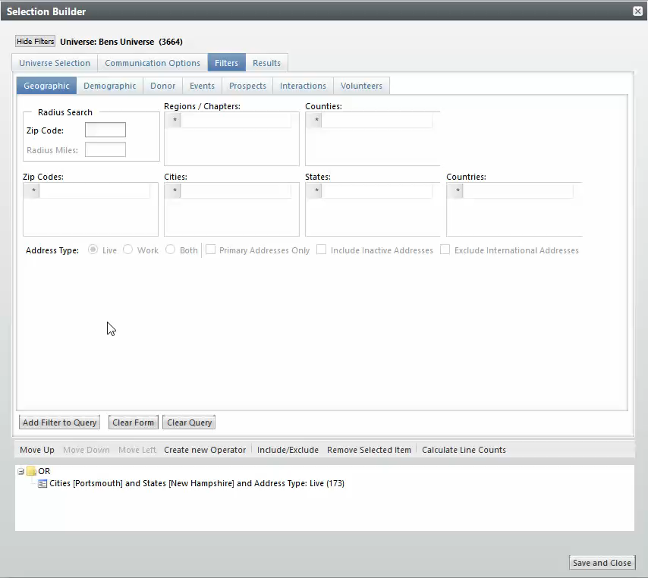
Each tab logically groups items of filters together
Revenue Filter utilizes Reporting Filters
Pre-Canned Date logic
Adding second filter line now has two distinct sets of logic Or’ed together.
Calculate Line counts calculates for each independent line.

Slide 22
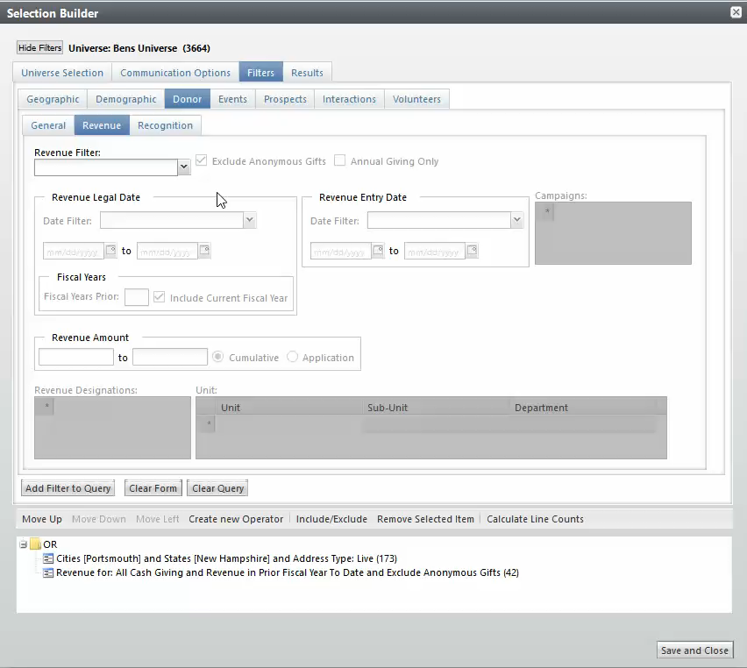
Default filters apply in certain areas. Exclude Anonymous defaults when using any revenue filter.
Unit collection contains UI Logic on a per row level of the collection.
Include/Exclude option will NOT the selected line.

Slide 23
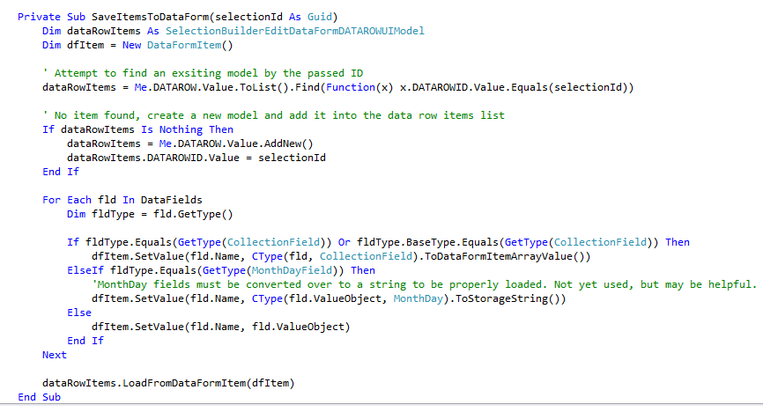
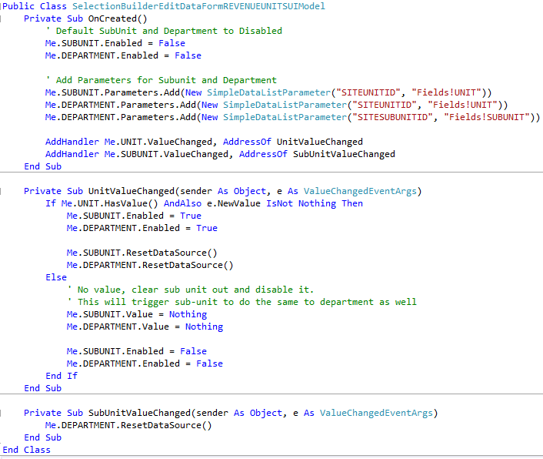
When adding a filter to the query, the UIFields that make up the user input filters get translated into a hidden collection for the actual data passed into the CLR function
For collection fields, utilizing the OnCreated method of the partially generated class allows us to add further logic inside the collections

Slide 24
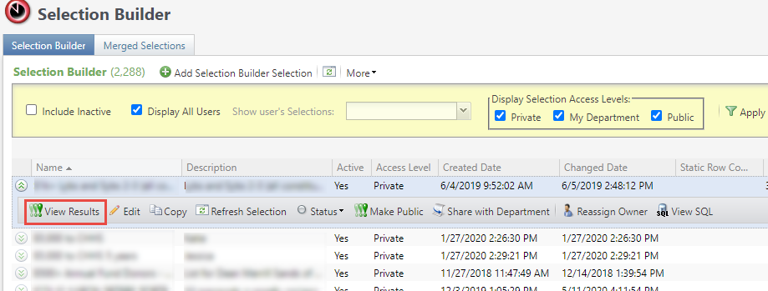
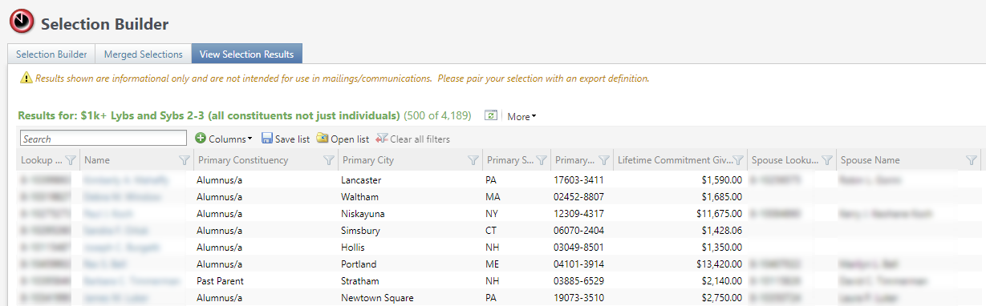
List Builder allows for more meaningful interaction with selection data
More display columns
Export to Excel
Interact with Constituent Record

Slide 25
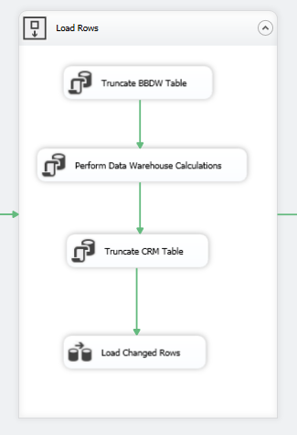
View Selection Results data set is pre-processed in the data warehouse
Executes a stored procedure
Writes the data back to the CRM transactional database
Provides rapid loading of results with the trade-off of stale data

Slide 26
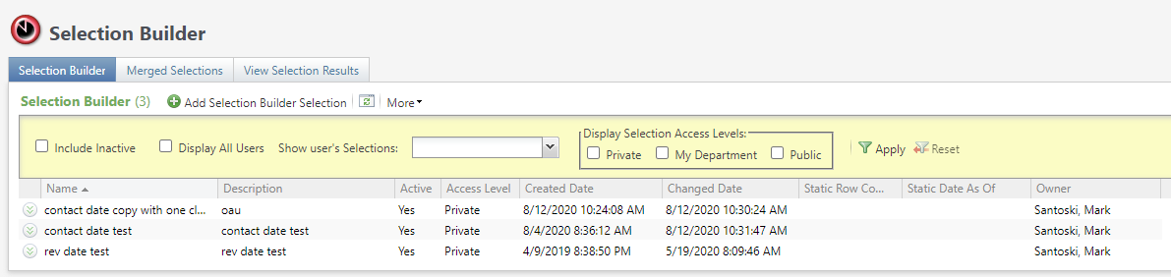
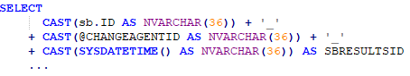
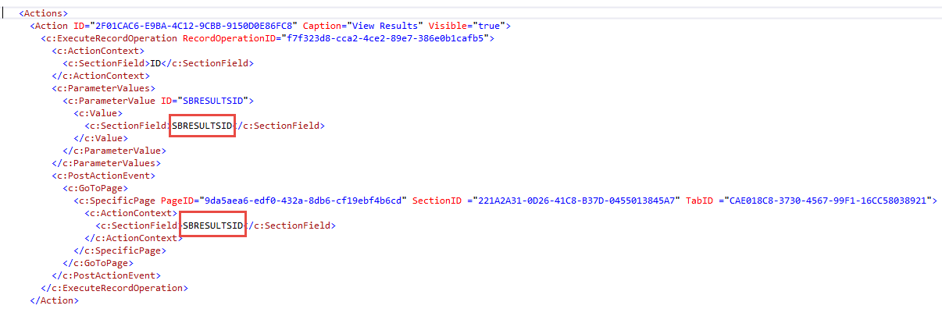
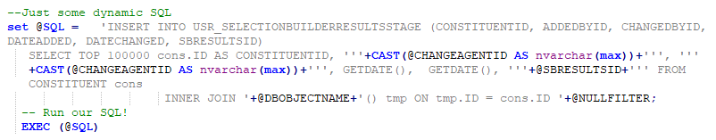

Slide 27
Selection Builder Roles
Trax
Admin
Selection Builder Manager
Selection Builder
Default Access
(None)

Slide 28
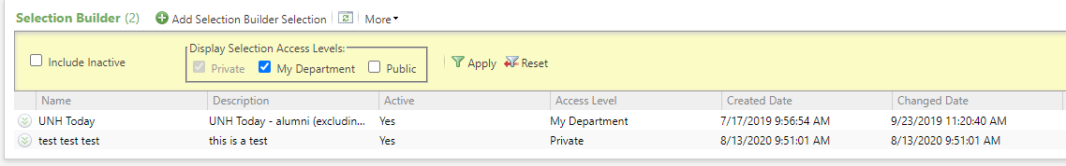
Selection Access Levels
Private
My Department
Available within the department of the Selection Builder Manager who approved it
Public
Available to everyone who has Selection Builder access
Reassign to Selection Builder Manager to promote
Reassign to Trax Administrator to promote
Initial state of any Selection
Approved by Trax Administrator
Selection Access Level

Slide 29
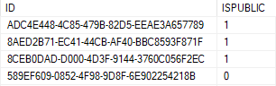
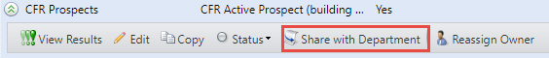
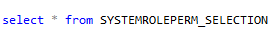
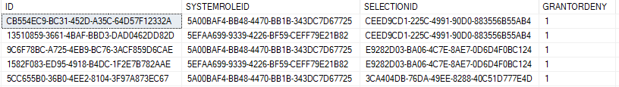
Selection Access Levels

Slide 30
Selection Builder – Update Existing Instances
Update Selection Builder Instances as code changes

Slide 31
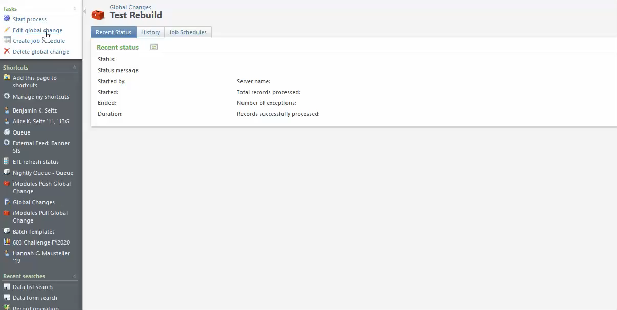

Slide 32
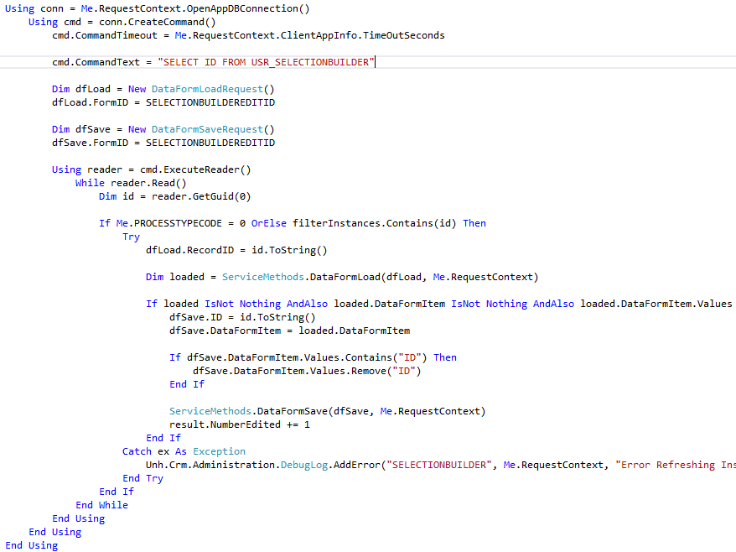
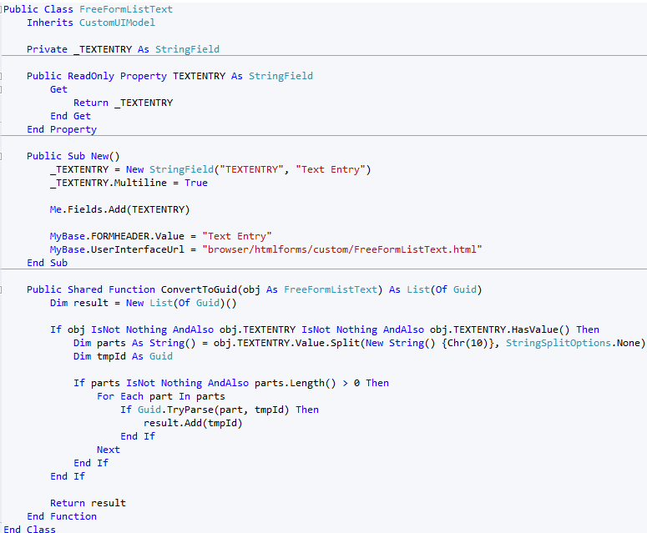

Slide 33
User Page History
Capturing what users are doing in the system

Slide 34
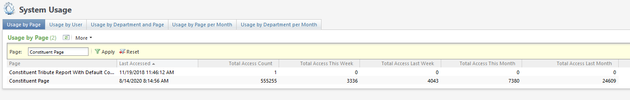
Ability to see how often a page is accessed by users
Ability to see how many pages a specific user is accessing
Ability to see access stats broken down by Department

Slide 35
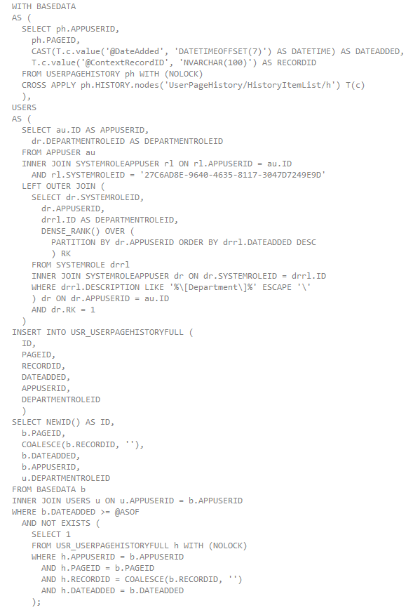
Selects from system table USERPAGEHISTORY
Table is populated as users access pages in the system
Only stores the last 10 records accessed for a given page
Department is based on selection builder roles (USERS CTE)
Stores snapshot in custom table, ensuring duplicates are not added
Runs every 5 minutes

Slide 36
Lessons Learned – Business Requirements
Have well defined Business requirements
Initial goal was to provide an easy-to-use for end users tool to create selections, similar to Reeher. This was the driving force for what to include / logic for items.
Agreed upon roles for logic
Created early during implementation phase of CRM, 1.5 years before go-live
Having more CRM knowledge, with how users were using the system would have been helpful

Slide 37
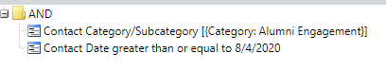
Lessons Learned – Boolean Logic
Boolean logic clauses are not 100% intuitive, even with this simplified approach
Take two similar filter sets into consideration…
Returns 7 matched constituents
Returns 9 matched constituents

Slide 38
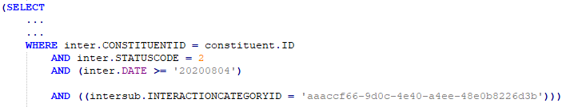
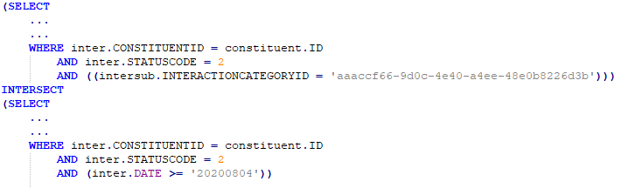
Lessons Learned – Boolean Logic
While the clauses could seem to be logically equivalent, they result in very different queries

Slide 39
Future Goals – Context Based Results
Allow for Contextual based results
IE: Filtering for Constituents who live in a city. Results would display the address with the city that generated the match, and not just primary address

Slide 40
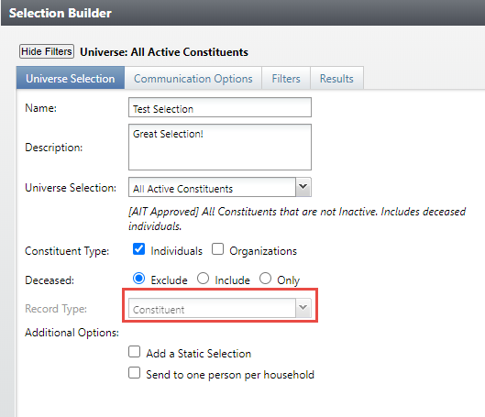
Future Goals – More Record Types

Slide 41

Benjamin Seitz
Benjamin.Seitz@unh.edu
Mark Santoski
Mark.Santoski@unh.edu

Slide 42
Benjamin Seitz
Benjamin.Seitz@unh.edu
Mark Santoski
Mark.Santoski@unh.edu

Slide 43



